Slide 1

Skills for Data & AI Managing Positions
Josip Saban
josipsaban@gmail.com

Slide 2
Space: the final frontier. These are the voyages of the starship Enterprise. Its continuing mission: to explore strange new worlds. To seek out new life and new civilizations. To boldly go where no one has gone before!
JEAN-LUC PICARD
starship captain

Slide 3
About me
Finished Computing at Faculty of Electrical Engineering and Computing, Zagreb in 2004, Cotrugli MBA in 2011, now on Executive MBA in Innovation & Entrepreneurship on TU Wien
Started as web developer, then moved to databases and business intelligence with strong focus on management
Around seven years in Erste Bank, worked in several areas, starting in Erste Croatia and now in Erste Digital Vienna
Owner of Meridian Data, specialized for data analytics and visualization
Details about my career path and partial portfolio are available at:
https://www.linkedin.com/in/josipsaban/
https://jsaban.github.io/ ( conference lecture slides, blogs, MOOC certificates )

Slide 4
Why this lecture
Because, over and over, experienced IT people go through three scenarios:
Internal promotion to management as only way to advance in the company
Internal or external promotion to management as part of their desired career path
Somebody must take over team/department and nobody wants to, then it goes to first person that “raises their hand”
Or worse…you are promoted by “a friend that wants to help you in career and brings you on board”
These scenarios can be great...except when they are not, and you are not ready

Slide 5
Executive summary ☺
“Successfully managing a data science team requires skills and philosophies that are different from those that arise in managing other groups of smart professionals. It’s wise to be aware of the potential organizational frictions and trade-offs that can crop up.” https://sloanreview.mit.edu/article/why-managing-data-scientists-is-different/
Actions
Take part in all parts of project life-cycle
Understand used data science landscape
Become really good at structured thinking
Define your own learning plan and agenda and share it with your team – ask the team to join
Skills
Creative Problem Solving
Data manipulation and cleaning understanding
Familiarity of statistics and quantitative techniques
Any programming language experience
Understanding of data visualization and machine learning
Deep understanding of storytelling
Deep agile AND waterfall project management experience
Qualities
Balances technical nuances across data domains, math/stats, machine learning and software and connects them to business context and value
Earns respect and trust of technical team by contributing at big picture level (are there any blind spots, are we on the right track, challenging assumptions)
Adds structure (e.g. workflow, an agile process with feedback loop and code reviews, code repository, documentation), absorbs shocks and removes barriers, identifies disconnects (say, between business and data science or between data science and dev ops) and builds consensus, facilitates smooth work environment, manages workload
Knows how to launch data science solution for real-world applications .. plans and manages or coordinates the business process changes, production-level code and IT operations

Slide 6
Good and bad reasons for becoming a manager
Management is art and science of its own, not “extension of technical career”
If you are an excellent programmer and thrive on code and process quality, it says very little about your management potential
You need a different set of skills, that are often not “natural” to engineers
Please read:
Ten reasons Why You Should Become Manager
Seventeen Reasons Not To Be A Manager

Slide 7
Again...why this lecture?
When you are not ready? Usually it falls into two scenarios:
You finish university where you are trained to become an engineer and you somehow end-up there
You didn’t go to university, started “working” with 18 and by 25 and you think that only management is technical management and all these “university guys in corporates do is a waste of time”
Hopefully, you get a first good manager that knows how to manage potential managers
I got a very bad first manager, and that moved me to a path of management discovery
You should know that you want this - you must understand that this is a career path

Slide 8
If you do not want to fail…
…same as in everything else –prepare!
Although I went to two MBAs, and it is amazing experience, it is only part of the story
You have excellent free online resources – for example management courses on Coursera
Some people cannot learn in unstructured way, and then they need a learning path
Personal MBA is a great resource of best books in various areas of management
Find a mentor that knows and wants to pass knowledge
Management is harder to “learn” for technical people but with high transferability rate

Slide 9
Management and leadership
So…”managers do nothing all day, they just go to meetings and talk”
If this is your opinion, then you either don’t know what they do, or you have a very bad manager
In the second case “escape” as soon as possible
In order to manage somebody, you first must lead
You must be a role model in good and bad times
It’s an art, not science - mixture of your creativity, personality and ethics
Change company if you, after honest self-evaluation, are not growing with the desired pace
Employment in one company only has meaning if both sides get what they want

Slide 10
Day one – hour one
The day has come - your first day in management of a new team - you come to the office...and now what?
You are no longer “protected” by your code, IDE, team and processes - you stand alone
Same applies to internal promotion in the team and department you are familiar with – it is a new start
It is quite normal you feel, up to a point, some aspects of impostor syndrome
In the first week you must do four major things ( and nothing else! )
Learn your environment
Meet your team and create a team overview
Meet your boss, get to know him and learn his expectations
Create general overview of everything
Skills needed – curiosity, communication, empathy, understanding and lack of ego
Technical skills needed – best you can, ideally in the area of the team activity – non-technical management in IT usually doesn’t end up well

Slide 11
Task one - learn your environment
This does not mean you to drink coffee all day...it means:
Get a “feeling” of the team and area - how people talk, is this a formal or informal environment, dress code
Try to catch on tech stack and current affairs
If you don’t know something, note it down and ask later – Google is your friend
Don’t introduce yourself to everyone and show off...you are here to lead, not to impress by appearance
If possible, in the first week, except activities listed before, stay low and observe
Expect gossip about you - this is good, it is first step in acceptance
Maybe you will have onboarding sessions with HR – this is excellent information gathering opportunity

Slide 12
Task two - meet your team
You need to form independent view of your team
It is a perfect opportunity to, informally, learn what were the mistakes of your predecessor, and put them on to-do list – this is where your tech skills should come out – you should understand problems
In the beginning you need to rely on your manager’s observations, but your priority is to start forming opinions about the team
Start asking key questions and look for gaps - how they feel about themselves, their colleagues and as part of the wider company
To create an overview you need to combine all these views, compare them against each other and get a “realistic” overview

Slide 13
Task two - meet your team
Introduce yourself to the team - this is the start of building a relationship
Meeting has to be personal - in person or by video link
After it is done you have to make 1-1 with each team member, not more than 30 minutes, according to his schedule, in informal tone
You need to get, from each team member, following information:
What is his responsibility
What are they currently working on
Their opinion about the team and what is working well compared to what is not
Summary of this data gets you an overview what the team is doing

Slide 14
Task two - meet your team
Schedule difference - makers VS managers – mandatory read from Paul Graham
Managers schedule their day around hourly blocks in calendar
Makers are most productive in blocks of about half a day
Don’t be tempted to drop meetings to your staff on your convenience
Sometimes it is unavoidable, but if you can, try to protect their time

Slide 15
Task three – talk to your manager
Now it is time for a different kind of meeting - meet your manager
Don’t wait for him to schedule the meeting - be proactive and request his time - it is what he expects
Follow the same procedure - use open-ended questions, listen and take notes - you need to get insights about...everything :)
Most importantly you need to get his opinion of the team, some of his personal ( subjective ) thoughts on their quality ( “superstars” or “average” ), details about clients
You, at any cost, must not leave this meeting without a clear list of your first tasks - they may differ from what you need to do, but you need to manage “up” as much as “down”
Now you are ready for creating your first week overview

Slide 16
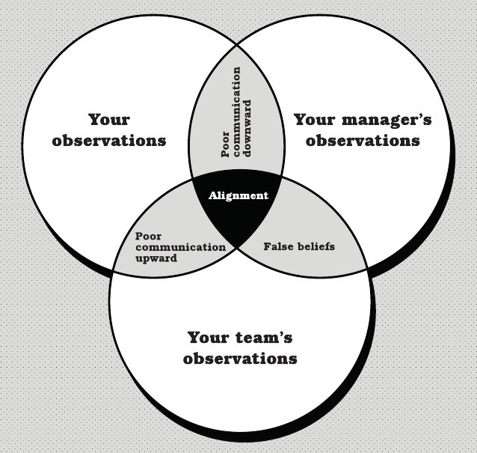
Task four – create overview
You form your overview by taking what you’ve learned from the team, your manager, and yourself
Visualizations help and creating an overlay in a form of Venn diagram is the usual approach
Then you can begin to work out where particular observations fit into the intersecting circles

Slide 17
Task four – create overview
Alignment are observations or beliefs that you, your team, and your manager all share
Poor communication downward is where you and your manager share observations or beliefs, but the team is either unaware or disagrees
Poor communication upward is where you and your team share an observation or belief, but your manager is unaware
False beliefs is where both your manager and the team have a conflicting observation or belief from your own

Slide 18
Action list
Now we need to create an action list for week two
You began with regular one-to-one meetings with your staff and your manager
You created an overview in which you put categorized observations and future to-do items
Then pack your things and head on home, with a feeling of achievement

Slide 19
Now go home and forget about work!
This is extremely important - you need to disconnect from work
Your team overview is done, you met your team, your new boss and you got an initial feeling of the place...it is a lot of work done
Now the week ends, and you disconnect - company doesn’t exist till Monday
How you proceed from there depends on each company and specific demands of that environment, but you made a huge first step

Slide 20
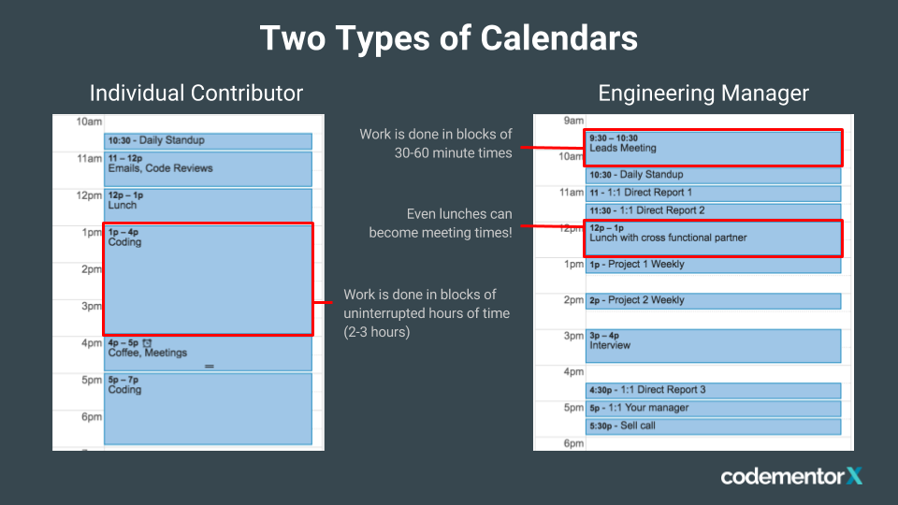
Manage yourself
Before you start week two you need to be ready for self-management
You can read about this in my article, but you need some tools and lots of self discipline - your time just became your greatest asset
In summary, you should take care of…
…your calendar - for organizing your time
…your to-do list - for organizing your tasks
…your email inbox - for organizing your messages
…your place to capture information - when you’re not in front of other tools

Slide 21
So…what skills are needed?
Personal summary of skills – being a good and educated person
Management is like officers in the army – it is not about “what” but about “how”
Untrained or under-qualified managers usually fail in the “how” category
You need communication, empathy, political wisdom, technical side…but basic skill is being “classy”
Sometimes you have to do something uncomfortable – what will be remembered is “how” you do it
What we consider toxic managers are not those that didn’t want to do something, but lacked the knowledge and skill “how” to do it
Good luck and I hope you will like management profession!

Slide 22

Thank you for your time

